Slide 1
PERSPECTIVE ON CHARITY LAW, ACCOUNTING AND REGULATION IN NEW ZEALAND Session 10: Charity Law and Accounting in Te Ao Māori Presenters: Damian Stone Alex Wilson

Slide 2
Introduction
Māori charities in context - Background and Data
Types of Māori charities
Case study - A closer look at Treaty settlement structures
The future

Slide 3
Māori Charities in Context Background and Data

Slide 4
Māori charities in context - Background and Data
The traditional heads of charity
Advancement of education
Relief of poverty
The resurgence of the collective
Māori Trust Boards and Rūnanga
Social service delivery and devolution
Present day benefit delivery

Slide 5
Māori charities in context - Background and Data
Māori and the development of charities law
The abolition of the “blood ties” restriction
Section 5(2)(a) of the Charities Act 2005
Crown Forestry Rental Trust litigation
The distinction between earning money and spending it

Slide 6
Māori Charitable Entities
Currently 27,829 Charities in NZ
No requirement to register as Maori Entity
How do you define?
977 associated with Maori Initativatives
Notes:
Register – At present there is no specific requirement when completing an application with Charities Services to designate the entity as a Maori Entity
Definition – At the same time, how do you define what a Maori entity is? Is it an organisation whose primary beneficial base Is Maori? does benefiting one Maori count?
These are probably questions that Charities Services have had a difficulty in answering so has been put into the to hard basket.
In maoridom you are either Maori or your not, there’s no in-between. So maybe the same approach can be taken for Maori Charities. Do you identify as a Maori Organisation?
Taking it one step further, requesting what Iwi or Hapu you benefit. Such Data gathering exercises could assist Maori Charities to connect with their people going forward into the future.
977 Associate Entities – Because there is no strict definition of a Maori Charity, Sorting the data held by charity services has proved problematic. However I think it is important to provide a snap shot of Maori Charities using some clever search techniques such as the use of maori words in the name of an entity, sorting by purposes of the charity, etc.

Slide 7
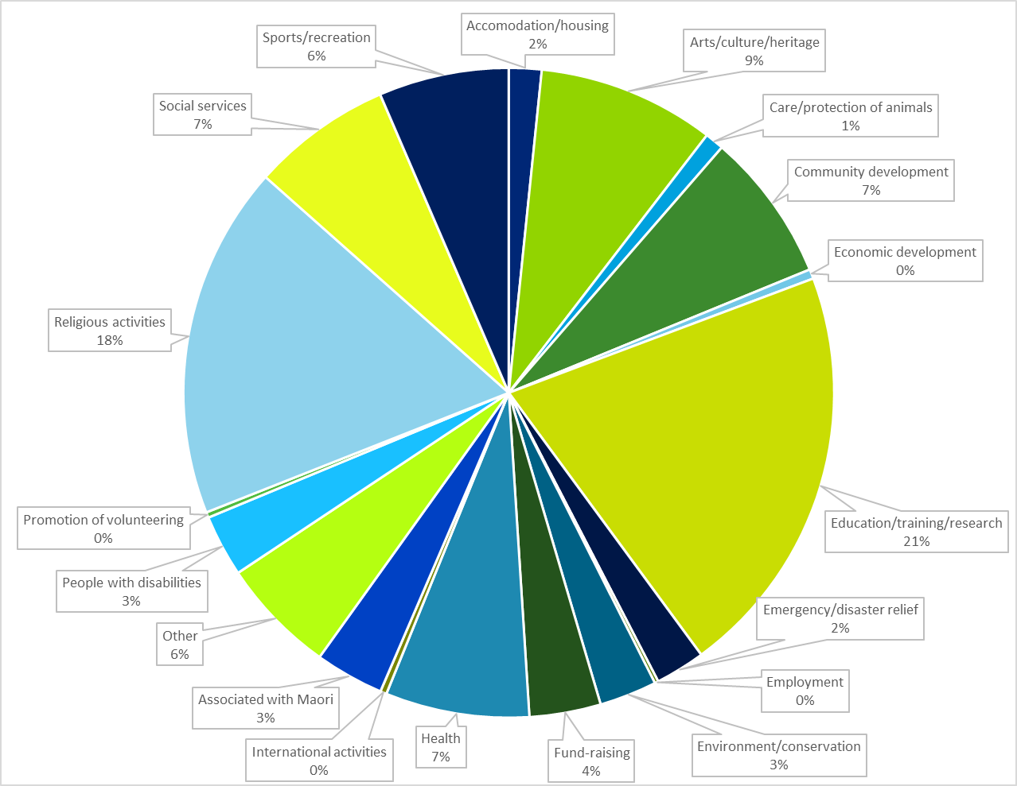
Māori Charitable Entities
Notes:
Out of these 977 Entities sorted by Purpose, the majority have noted that Education, Training and Research is their primary reason for existence. Followed closely by Religious Activities.

Slide 8
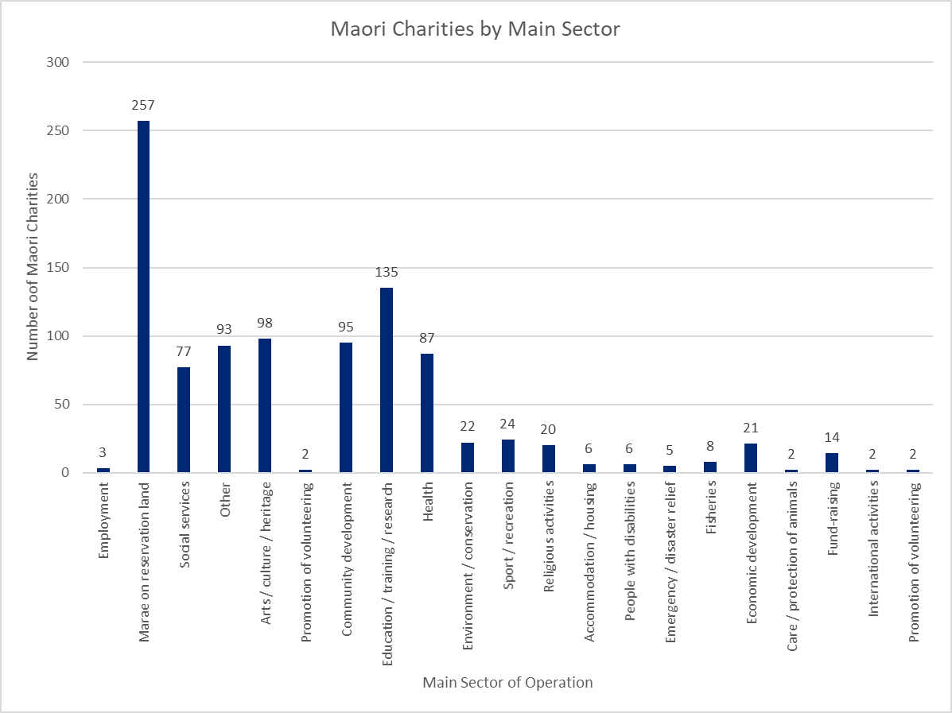
Notes:
Looking at the Stats from a different view based on Sector, we can see that the majority of Maori Charities are our Marae

Slide 9
Maori Charities by Region of Operations
Northland, 88
Bay of Plenty, 165
Remaining 186 Maori Charities have a nationwide reach
Auckland region, 96
Waikato, 59
Gisborne, 48
Taranaki and Manawatu, 131
Hawkes Bay, 66
Nelson, 23
Wellington, 56
Canterbury, 33
Otago, 27

Slide 10
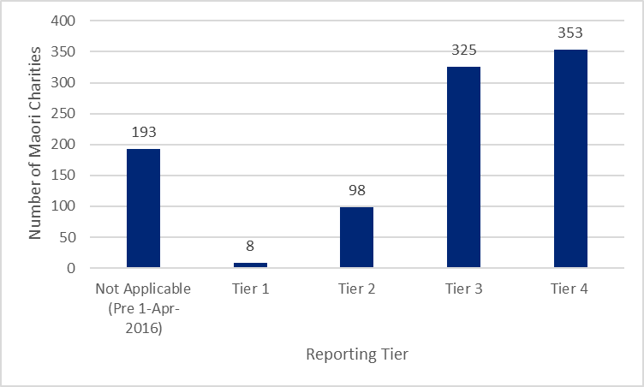

Slide 11
Types of Māori charities

Slide 12
Maori Land Trusts and Incorporations
Constituted under Te Ture Whenua Maori Act 1993
Charitable Trust created to provide for social returns to owners
Notes:
Maori Land Trust’s and Incorporations are constituted under the Te Ture Whenua Maori Act 1993. (Previously the Maori Affairs Act 1953)
The Act allows or a number of structures to administer land on behalf of owners, shareholder or beneficiaries.
Under the Maori Lands Trust’s Category we have three main structures.
Ahu Whenua Trust’s – Has a set ownership base, is constituted by a trust order and is a good vehicle to utilise the land.
Whenua Topu Trust – There is no set ownership. Ownership or beneficial interest in the trust is by way of whakapapa back to a Tipuna.
Reservation Trust – these Trusts are generally set up to administer land with special significance such as Marae, Pa sites, Urupa, etc.
A Maori Incorporation is the commercial equivalent of a company. These structures were generally used to amalgamate various blocks and create a vehicle to administer the land on the various owners behalf's.

Slide 13
Types of Māori charities
Māori Trust Boards
Generally operate for charitable purposes
Hauraki Māori Trust Board
Maniapoto Māori Trust Board
Tai Tokerau Māori Trust Board
Tauranga Moana Māori Trust Board
Tūwharetoa Māori Trust Board
Whakatōhea Māori Trust Board
Whangaroa Māori Trust Board
Section 24B of the Māori Trust Boards Act 1955
Marae
Section 338 of Te Ture Whenua Māori Act 1993
Section 218 of Te Ture Whenua Māori Act 1993

Slide 14
Types of Māori charities
Māori fisheries
Mandated iwi organisations
Asset holding companies
Te Ohu Kai Moana
Maori forestry
Crown Forestry Rental Trust
Social services
Manukau Urban Maori Authority Incorporated
National Urban Maori Authority
Whānau Ora
Others
Post settlement governance entities (PSGEs)

Slide 15
Case Study: A closer look at Treaty settlement structures

Slide 16
Case Study – A closer look at Treaty settlement structures
Crown policy
20 questions and general policy
Crown does not settle on charities
Enforceability and other issues
PSGE must therefore be non-charitable on receipt of assets
Non-charitable purposes
Whai rawa
Individual benefits
Future activities

Slide 17
Post Settlement Governance Entities
What is a PSGE?
Breaches of the Treaty of Waitangi
Claim relates to pre 1992
The Process
Pre Negotiations
Negotiations
Legislation
Settlement
Notes:
What is a PSGE - A PSGE is an entity or a group of entities that administer assets on behalf of a claimant group.
To understand how and why these entities are derived, we need to step back and look at the process for Treaty Settlements.
Claims for breaches of the Treaty of Waitangi before 1992 are known as historical claims. Settlements aim to resolve these claims by providing some redress to claimant groups.

Slide 18
PSGE – Example Structure
Nga Iwi / Marae
Tax Paid to the IRD
Crown
Settlement assets
IRD
PSGE – MIO
(Māori Authority)
Distribution Income (including Māori Authority Tax Credits)
IRD Māori Authority Tax refund
PSGE – MIO
(Māori Authority)
Distribution (including Māori Authority Tax Credits)
Commercial assets
Iwi Fisheries Ltd
(Maori Authority)
Charitable
Trust
Iwi Development
(Investment Trust)
Charity to charity
distribution
Dividend Income (including Imputation Credits)
Dividend Income (including Imputation Credits)
Charitable Trust
(Investments)
Non-taxable
Commercial subsidiaries (if any)
Commercial subsidiaries
Commercial subsidiaries
Taxable
Commercial subsidiaries
Selected Portfolio Investments
Complying Trust
Charitable Trust
Company
Limited
Partnerships (if any)
Charitable Company
Limited Partnership

Slide 19
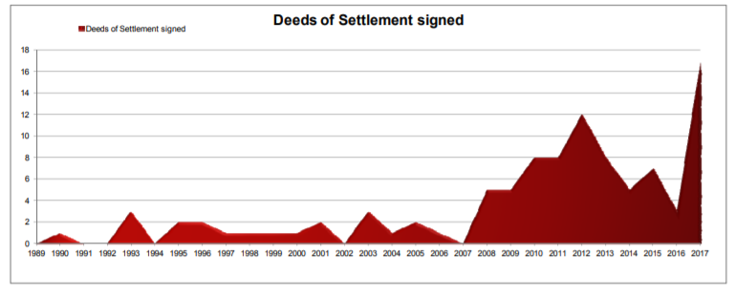
PSGE - Landscape
Source: Crown/Māori relations 2017 Briefing for the Incoming Minister

Slide 20
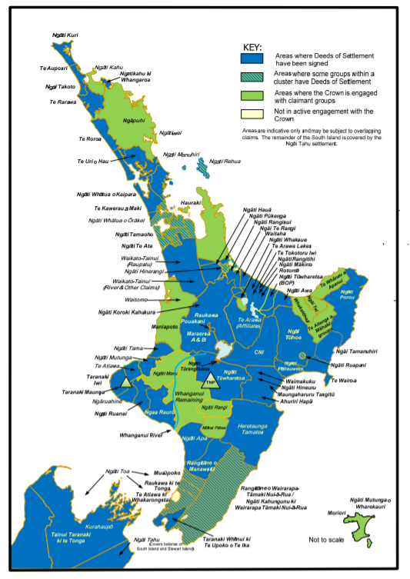
Source: Crown/Māori relations 2017 Briefing for the Incoming Minister

Slide 21
PSGE- Examples
Ngāi Tahu – Settlement of $170m in 1998
Current Asset Base of $1.6b
Waikato Tainui – Settlement of $170m in 1995
Current Asset Base of $1.25b

Slide 22
How Distributions are made
- Dividends / Owners Grants
- Kaumatua Grants
- Tangi Grants
- Education Grants
- Training and Education Programes
- Health Grants
- Business Start up Grants/Loans
Notes:
- Dividends / Owners Grants (Taxable)
Dividends = Unclaimed Monies
Owners Grants = Policy put in place and generally no Unclaimed Monies
- Kaumatua Grants (Taxable)
Policy put in place, but generally all over 65’s
- Tangi Grants (Non- Taxable)
Policy put in place, but generally a one of grant
- Education Grants (Non – Taxable)
Tertiary Grants paid directly or to service providers
Cadentships, Supporting Programs
- Business Start Up Grants/Loans
Policy or Terms put in place

Slide 23
The Future

Slide 24
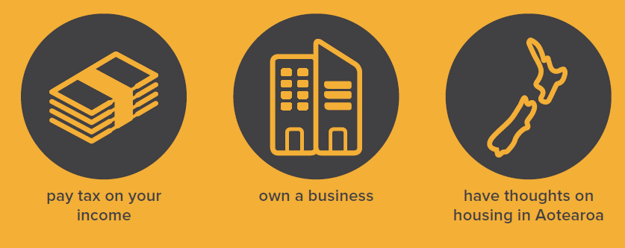
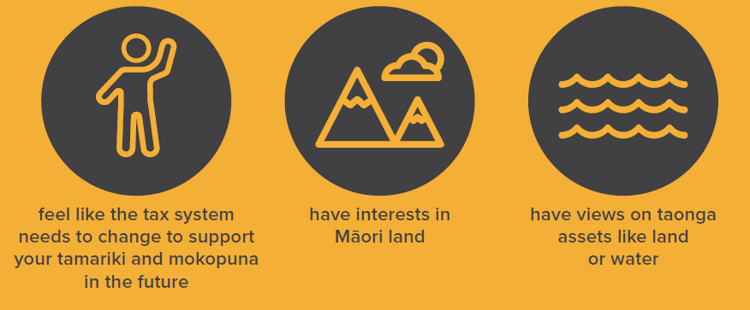
Māori Charities and Tax Reform
Notes:
Maori Charities as Part of Tax Reform
The Tax Working Group have recently released a “Future of Tax: Submissions Background Paper” which sets out a high level overview of the existing tax aystem and poses some general questions for feedback from all New Zealanders. Included in this background is paper includes a section on Te Ao Maori.
All Maori Individuals, companies, Trusts under which a Maori benefit are subect to the tax system will have a number of cross-cutting interests in issues on the Group’s agenda. This includes issues like housing, capital gains tax (CGT), charities and land taxes covered elsewhere in this paper.
This is an opportunity to ensure Maori Voices are heard, and they are open to all perspectives. Submissions close on Monday the 30th April with final recommendations to be made to the Government in February 2019

Slide 25
Accounting Framework for Public Benefit Entities (PBEs)
1
Has public accountability or is a large PBE with total expenses > $30million. PBE Standards
2
Has no public accountability, is not large, has total expenses < $30million but > $2million and elects to be in Tier 2. PBE Standards Reduced Disclosure Regime (PBE Standards RDR)
3
Has no public accountability and has total expenses < $2million, that elects to be in Tier 3. PBE Simple Format Reporting Standard-Accrual (PSFR-A)
4
Has no public accountability and is allowed by law to use cash accounting, that elects to be in Tier 4. PBE Simple Format Reporting Standard-Cash (PSFR-C)
Notes:
To set some context around this next next matter. We know that charities need to prepare their financial statements using standards dependant on which Tier Category System they fall into.

Slide 26
Accounting Framework for Public Benefit Entities (PBEs)
1
Has public accountability or is a large PBE with total expenses > $30million. PBE Standards
2
Has no public accountability, is not large, has total expenses < $30million but > $2million and elects to be in Tier 2. PBE Standards Reduced Disclosure Regime (PBE Standards RDR)
3
Has no public accountability and has total expenses < $2million, that elects to be in Tier 3. PBE Simple Format Reporting Standard-Accrual (PSFR-A)
4
Has no public accountability and is allowed by law to use cash accounting, that elects to be in Tier 4. PBE Simple Format Reporting Standard-Cash (PSFR-C)
Notes:
For Entities that fall in Tiers 3 and 4. They are required to prepare a “Statement of Service Performance”
This statement of service performance provides mainly non financial information which include things like
- What entity is seeking to achieve?
- The Goods and Services that the entity delivered during the year?
- It shall describe the outcomes that the entity is seeking to achieve?
- Describe and Quantify the output that the entity has delivered during the financial year?
There are other optional disclosures discussed in the standards, but these the core requirements.

Slide 27
Accounting Framework for Public Benefit Entities (PBEs)
1
Has public accountability or is a large PBE with total expenses > $30million. PBE Standards
2
Has no public accountability, is not large, has total expenses < $30million but > $2million and elects to be in Tier 2. PBE Standards Reduced Disclosure Regime (PBE Standards RDR)
3
Has no public accountability and has total expenses < $2million, that elects to be in Tier 3. PBE Simple Format Reporting Standard-Accrual (PSFR-A)
4
Has no public accountability and is allowed by law to use cash accounting, that elects to be in Tier 4. PBE Simple Format Reporting Standard-Cash (PSFR-C)
Notes:
Up untill now, Tier 1 and 2 entities have not had a requirement to prepare a “Statement of Service Performance”, however the the XRB – External Reporting Board (An independant body that sets accounting standards in New Zealand) has recently issued PBE FRS 48

Slide 28
Financial Reporting Changes
PBE FRS 48 – Service Performance Reporting
Effective from 1 January 2021
Principals not prescriptive
How do you capture this non financial data?
The good news......
Notes:
PBE FRS 48 - Service Performance Reporting
The Standard itself is not prescriptive and provides a higher level principals approach.
It allows alot of flexibility and there is no template to follow.
Entities have to put some thought into what they are going to report and how they are going to report.
Due to this new standard applying to the Larger charities in the country, careful planning and consideration will need to be made to ensure the right data capturing mechansims are in place.

Slide 29
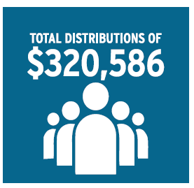
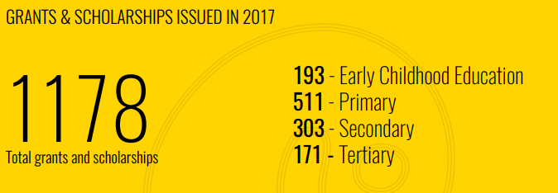
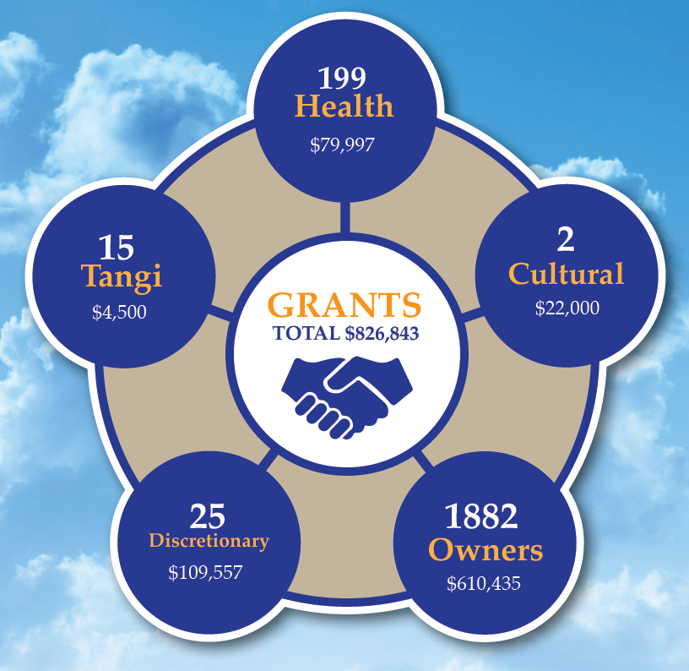
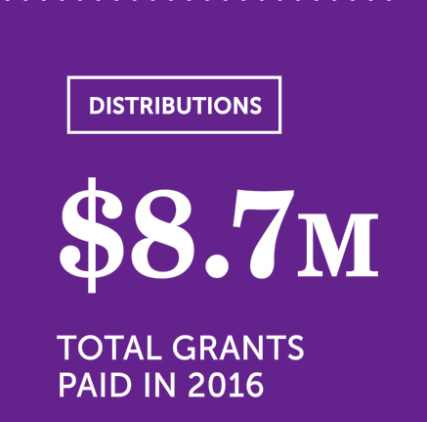
Financial Reporting Changes

Slide 30
The Future
Treaty settlement legislation
Removal of charitable status
“ring-fencing” of retained earnings
Iwi structures
Unlikely to every exhaust charitable purposes
Move over time to spending on non-charitable purposes
Flexibility to declare assets held for charitable purposes in the future

